Slide 1

PRESERVE YOUR HEART
Team ID : 22_AI_2A_17
Aman Bhadauriya (2101641520013)
Avantika Bajpai (2101641520036)
Abhinav Yadav (2101641520003)
Akhand Pratap Singh (2101641520010)
Abhishek Swaroop (2101641520004)

Slide 2
INTRODUCTION
Machine Learning is used across many ranges around the world. The healthcare industry is no exclusion. Machine Learning can play an essential role in predicting presence/absence of locomotors disorders, Heart diseases and more. Such information, if predicted well in advance, can provide important intuitions to doctors who can then adapt their diagnosis and dealing per patient basis.
Even though heart disease can occur in different forms, there is a common set of core risk factors that influence whether someone will ultimately be at risk for heart disease or not. By collecting the data from various sources, classifying them under suitable headings & finally analysing to extract the desired data we can say that this technique can be very well adapted to do the prediction of heart disease.
Machine learning proves to be effective in assisting in making decisions and predictions from the large quantity of data produced by the health care industry.

Slide 3
PROJECT OBJECTIVE
This project aims to predict future Heart Disease by analyzing data of patients which classifies whether they have heart disease or not using machine-learning algorithm.
The working of the system starts with the collection of data and selecting the important attributes. Then the required data is preprocessed into the required format. The data is then divided into two parts training and testing data. The algorithms are applied and the model is trained using the training data. The accuracy of the system is obtained by testing the system using the testing data. This system is implemented using the following modules.
1.) Collection of Dataset
2.) Selection of attributes
3.) Data Pre-Processing
4.) Balancing of Data
5.) Disease Prediction
3

Slide 4
Main Objectives :
The main objective of this project is to develop a Heart-Prediction System.
The system can discover and extract hidden knowledge associated with diseases
from a historical heart data set. Heart-Disease Prediction System aims to exploit
data mining techniques on medical data set to assist in the prediction of the heart diseases.
Specific Objectives :
Provides new approach to concealed patterns in the data.
Helps avoid human biasness.
To implement Naïve Bayes Classifier that classifies the disease as per the input of the user.
Reduce the cost of medical tests.
4

Slide 5
Feasibility Study
Technical feasibility
Operational feasibility
Economic feasibility
Feasibility is continued on next page…..
5

Slide 6
Technical Feasibility :
The main consideration is to be given to the study of available resources of the organization where the software is to be implemented. Here the system analyst evaluates the technical merits of the system giving emphasis on the performance, reliability, maintainability and productivity.
By taking the consideration before developing the proposed system, the resources availability of the system giving emphasis on the performance, reliability, maintainability and productivity.
6

Slide 7
Operational Feasibility :
We should make an estimation on the time require by the team members to
gain the knowledge about the needs / requirements of the Project in order to
make it a much more affective Project.
An estimate should be made to determine how much effort and came will go into the developing of the system including the training to be given to the user. Usually, people are reluctant to changes that come in their progression.
7

Slide 8
Economic Feasibility :
Economic feasibility is the most important and frequently used method for evaluating the effectiveness of the proposed system. It is very essential because the main goal of the proposed system is to have economically better result along with increased efficiency. Cost benefit analysis is usually performed for this purpose. It is the comparative study of the cost verses the benefit and savings that are expected from the proposed system. Since the organization is well equipped with the required hard ware, the project was found to be economically feasible.
8

Slide 9
Methodology
Architecture diagram
DFD’s
ER Diagram
Flow Chart
9

Slide 10
Methodology
Step 1 :- The first and the foremost step is to get the heart data. This data contains
several health parameters which corresponds to a person healthiness of the heart.
Step 2 :- Once we have our data set with us we need to process it . We cannot feed this
raw data into our machine learning algorithm so we need to process this data
set to make it fit and compatible for our machine learning algorithm.
Step 3 :- Once we process the data we need to split our data into training data and testing
data .this is because we often train our machine learning algorithm with training data and
we evaluate the performance of our model using the test data so this part is called Train
Test Split where we will original data set into training data and test data.
10

Slide 11
Step 4 :- Once we are done with train test split process we will feed our training data to
our machine learning model . In this case we are going to use a logistic regression model
because this particular case has binary classification i.e here we are going to classify that
whether the person has heart disease or not.
Step 5 :- When we will train this logic regression model with our trained data we will do
some evaluations to check its efficiency and performance so after that we will get a trained
logistic regression.
Step 6 :- When we will get the this trained logistic regression model we will feed new data
to our model it can predict whether the person is having a diseased heart or the healthy one .
So this is what we are going to do in our project.
11

Slide 12
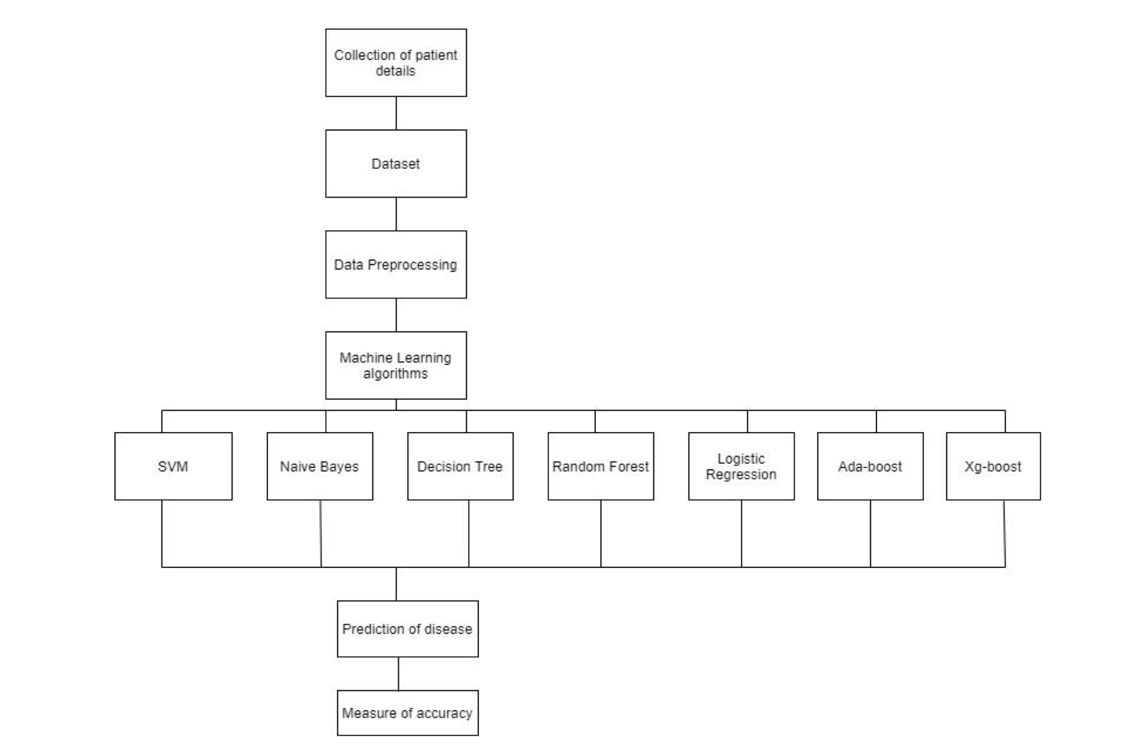
Architecture diagram
Figure 1: System Architecture
12

Slide 13
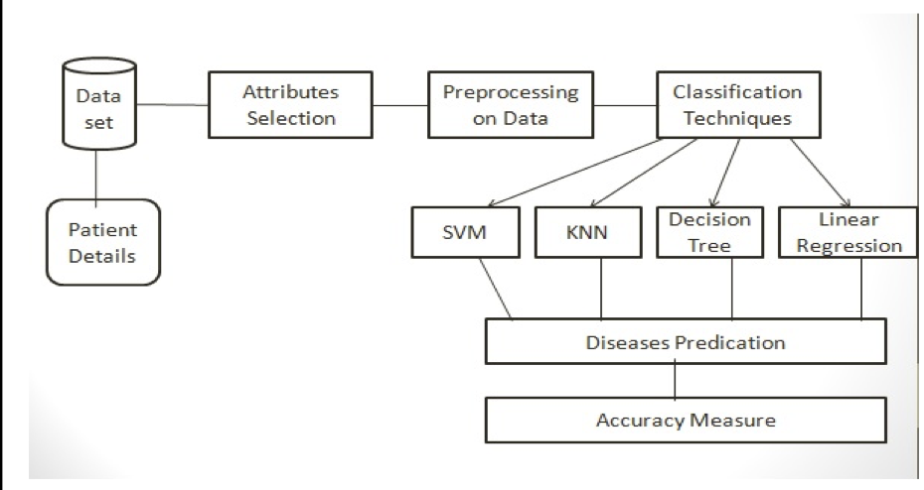
Figure 2: Architecture of Prediction System
13

Slide 14
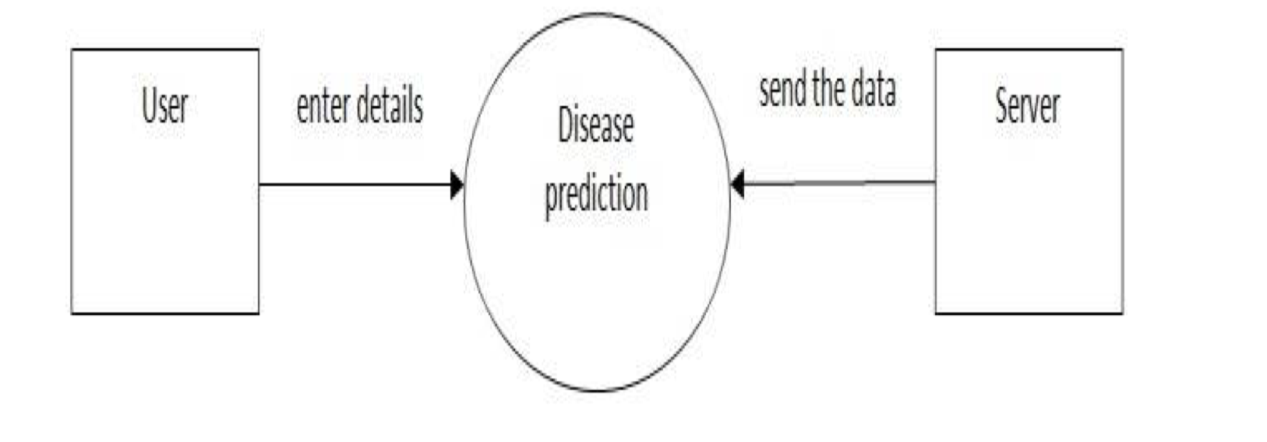
DATA FLOW DIAGRAM
Figure 3.1 : DFD
14

Slide 15
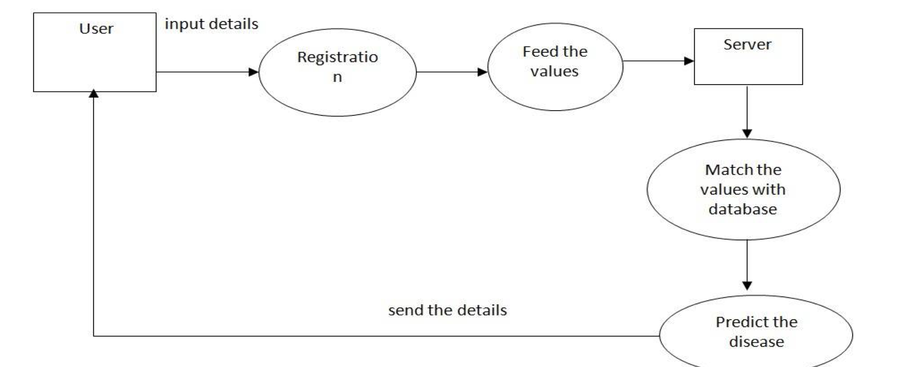
Figure 3.2: DFD
15

Slide 16
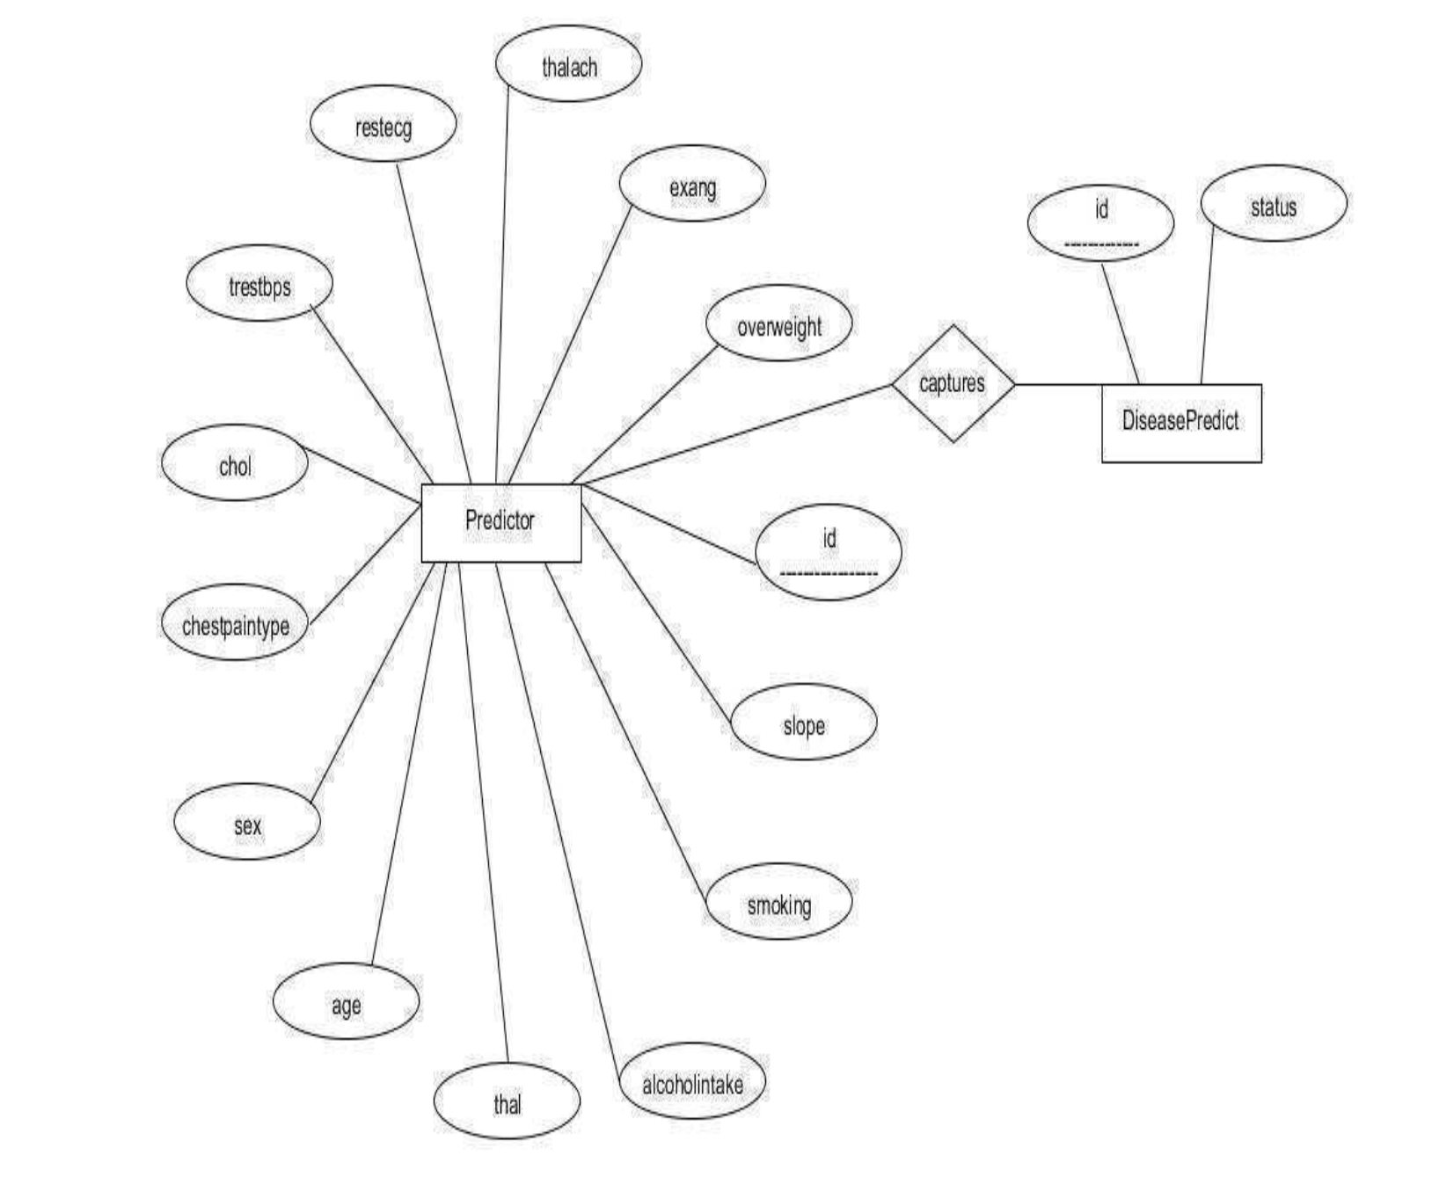
Entity Relationship Diagram
Figure 4 : ER Diagram
16

Slide 17
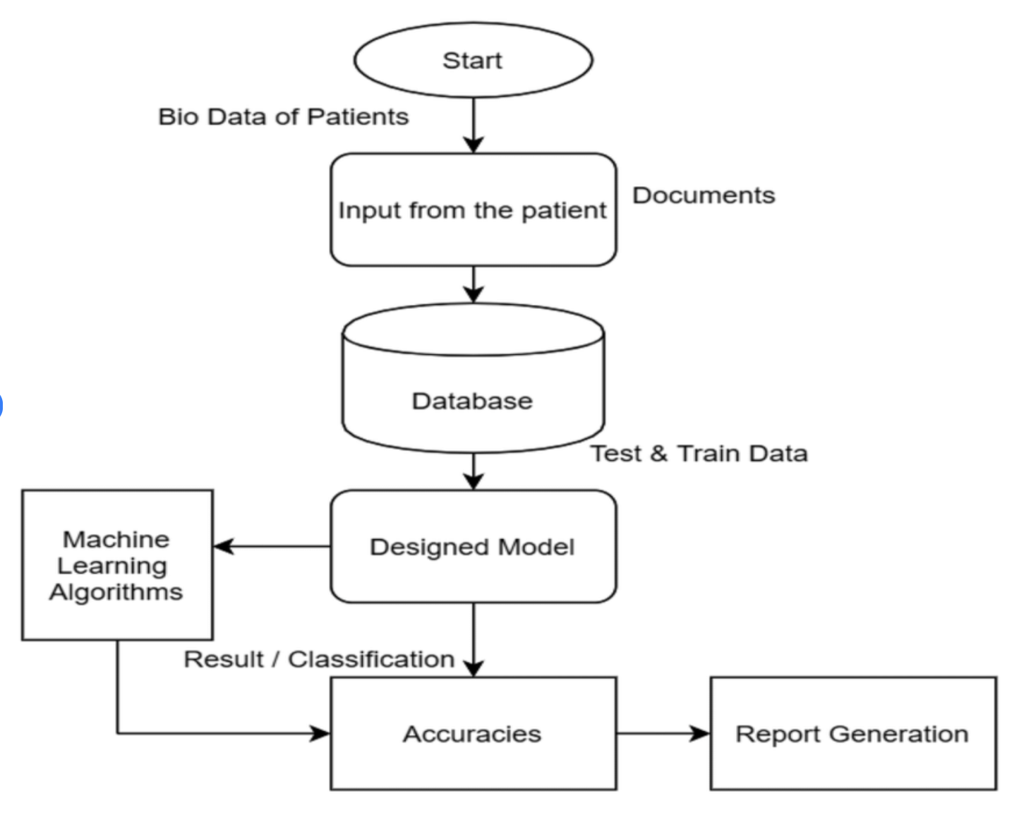
FLOW CHART
Figure 5 : Flow Chart
17

Slide 18
Tools/Technology Uses
Hardware Requirements
Processor → Intel Core III or above
Clock Speed → 800MHZ
System Bus → 32/64 bits
RAM → 2 GB or above
Hard disk → HDD/SSD 250GB or above
18

Slide 19
Software Requirements
Operating System → Windows/Mac OS/Linux
Browser → Any HTTP Browser
Technology → Python3.7
IDE → Jupiter notebook
19

Slide 20
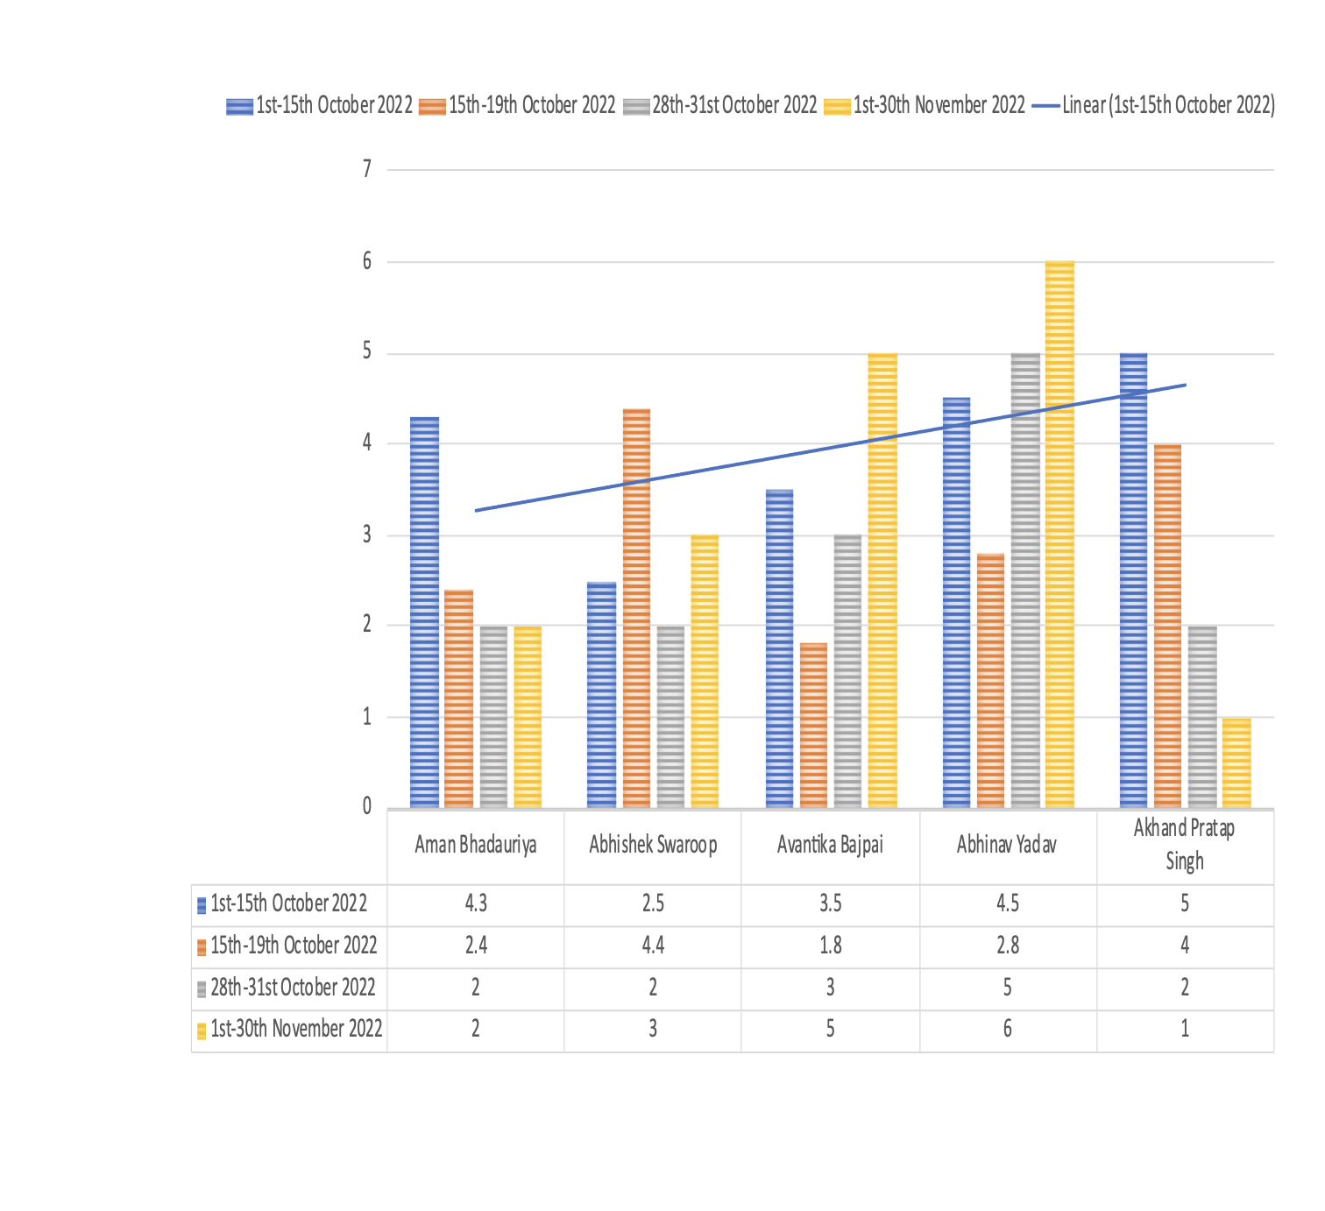
Feasibility Chart of the Project
Figure 6: Feasibility Chart
20

Slide 21
References :
Machine Learning Engineer (Google Services)
→https://www.coursera.org/learn/gcp-big-data-ml-fundamentals
GeeksforGeeks → http://www.geeksforgeeks.com/
Google → http://www.google.com/
Thank You
21

